Slide 1


Coral Reef Detection and Analysis
FINAL PRESENTATION
Caitlin Petro, Rohith Guptha Kona,
Kalyan Venkat Madireddy, Santosh Reddy Pasunooru

Slide 2
Table of contents
01
02
03
Deliverables
What can we provide to you?
Methodology
How did we achieve it?
Results
What was the outcome?

Slide 3
01
Deliverables

Slide 4
Classification 1
Mask Generation
Classification 2
1
2
3
Classification with U-Net
Mask Prediction with U-Net
Classification with ViT

Slide 5
Yolo Detection
Coral count
4
5
Coral detection using YOLOV5
Use Watershed Algorithm to count corals

Slide 6
02
Methodology

Slide 7
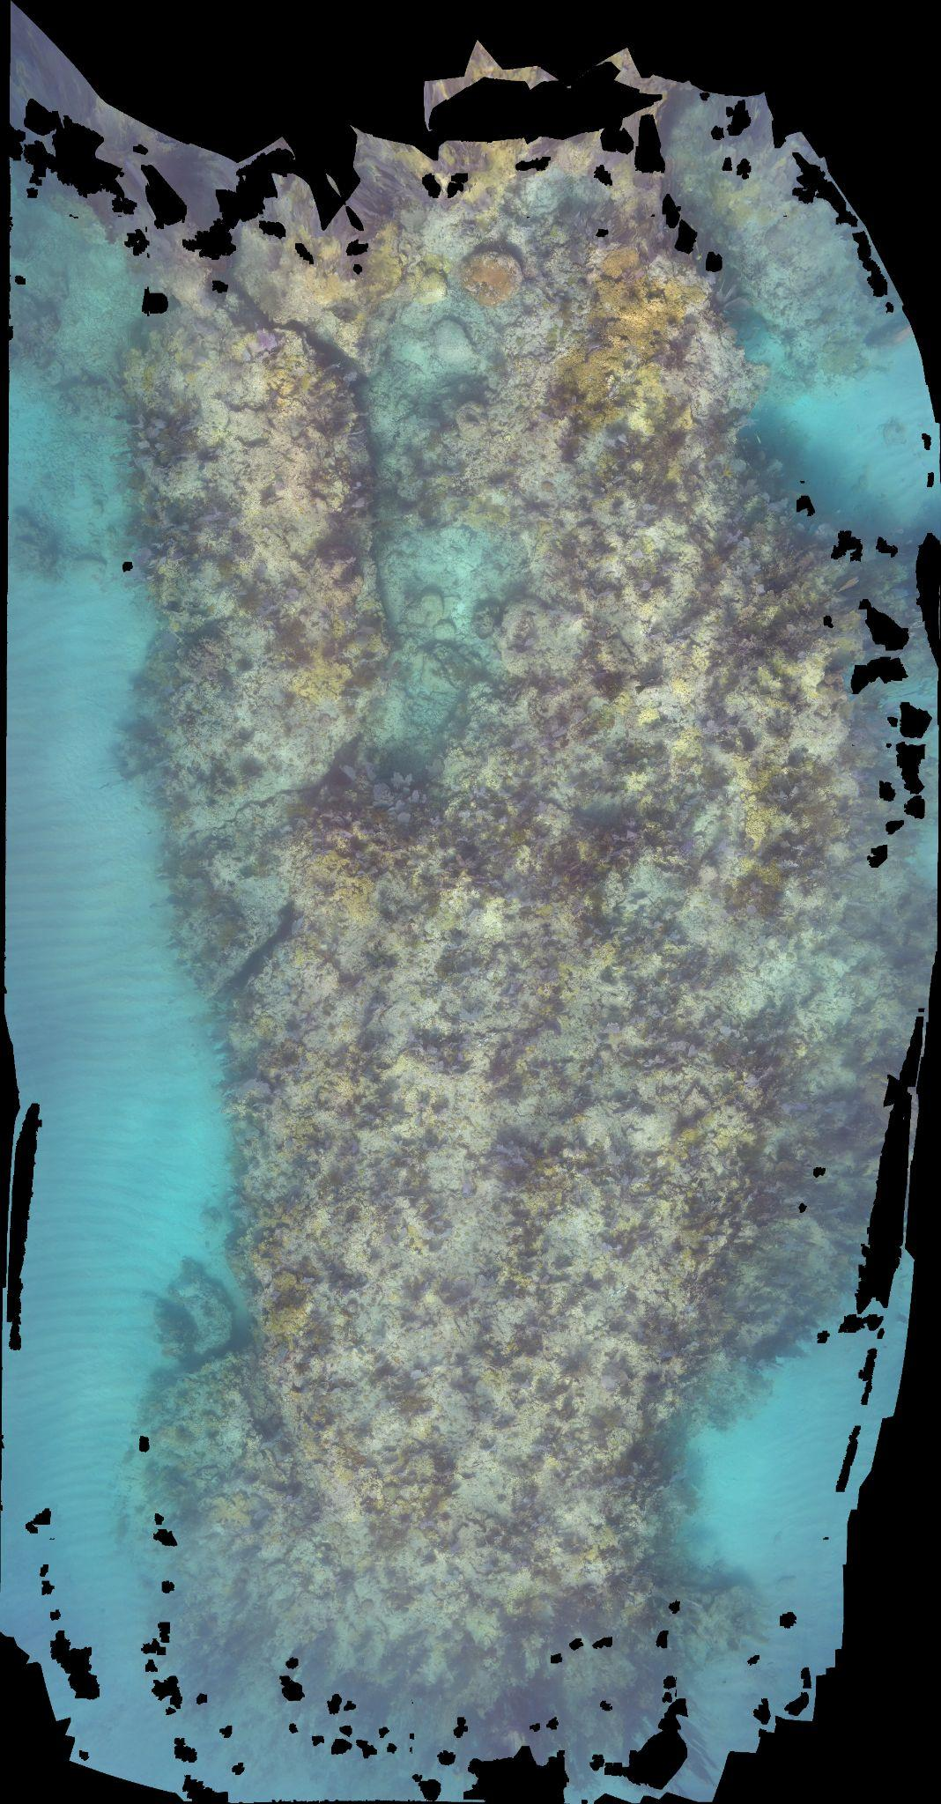
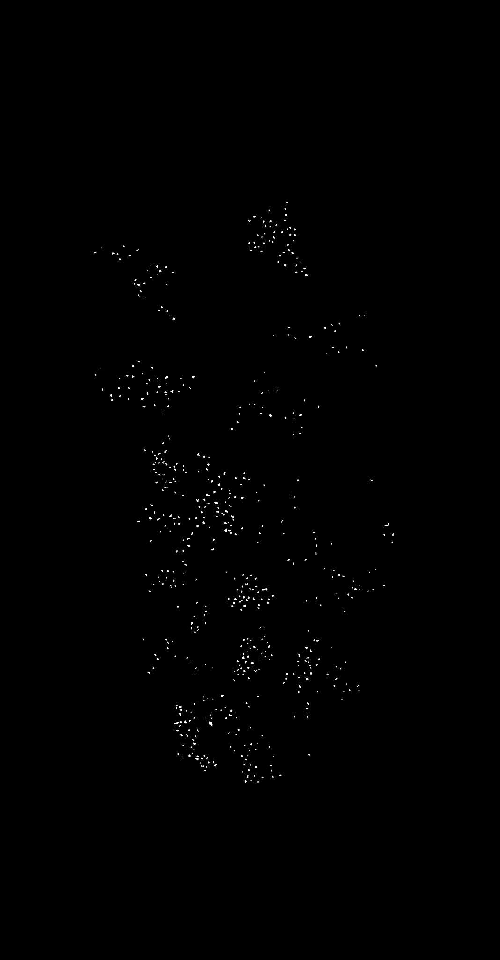
Data Processing
Data Overview
16 mosaic images, keys, scales
Generate 197,248 256x256 patches
Isolate 4,856 “useful” patches
2,661 Staghorn
2,195 Elkhorn
Apply pixel classification to patched masks

Slide 8
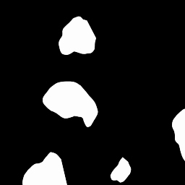

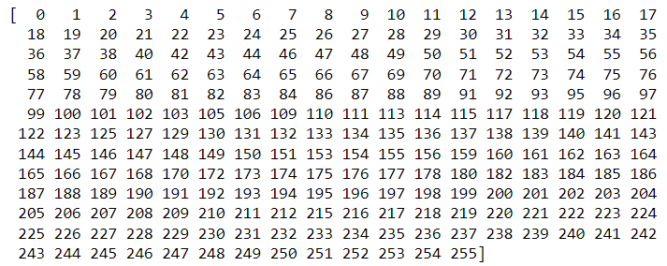
Pixel Classification
Carysfort 2019 Elkhorn Patch 2596

Slide 9

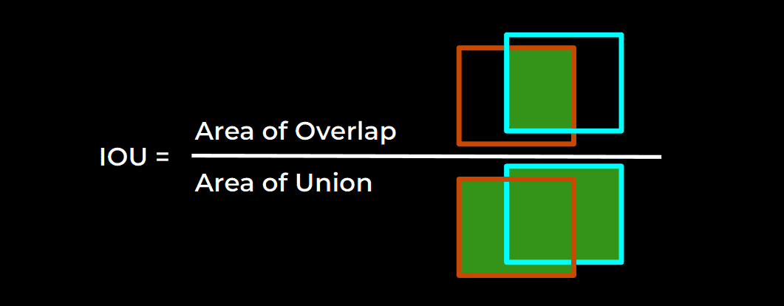
U-Net Overview
U-Net is a convolutional network architecture
First implemented in the Biomedical field for medical image screening purposes
Consists of a downsampling path, a bottleneck, and an upsampling path
IoU as measurement of accuracy
Softmax activation
Resnet34 backbone,
ImageNet encoder weights
Adam optimizer
85/15 Training/Testing Split

Slide 10
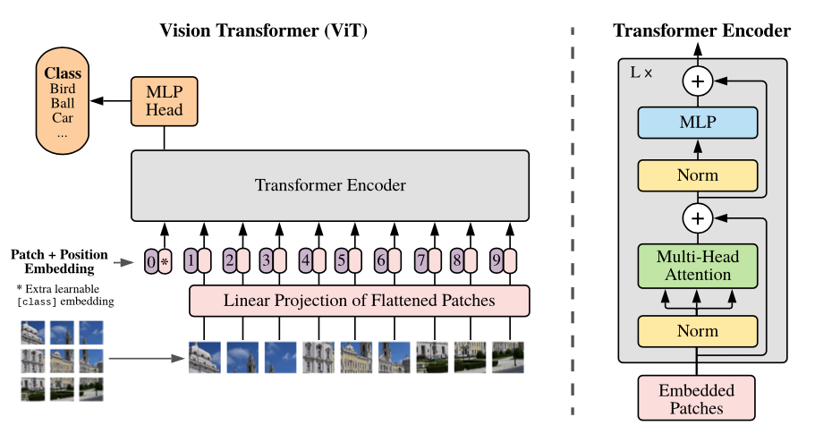
ViT Overview
Initially Transformers are used in Natural Language Processing for text-based data
50% less computations compared to CNNs
65/15/20 Training/Validation/Testing Split
Data Augmentation -> Patches -> Encode Patches -> Transformer Encoder -> Class Prediction
Patch Size = 8
Transformer Layers = 8
AdamW Optimizer

Slide 11
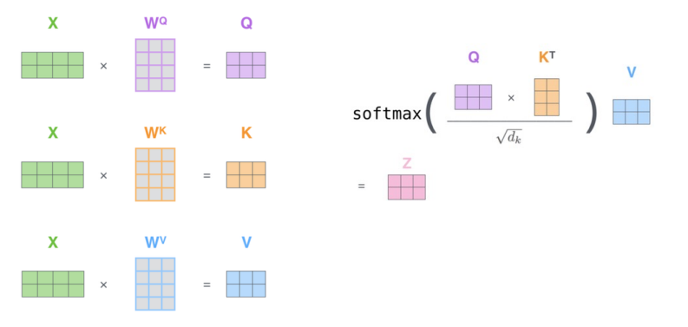
Self-Attention

Slide 12
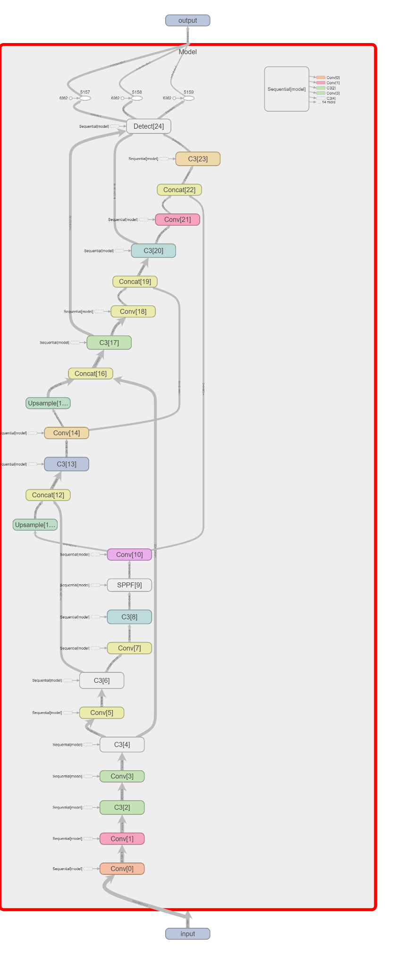
YOLO Overview
First object detection model that combined bounding box prediction and object classification into a single end to end differentiable network
Using YOLO V5 for object detection with 50 epochs and batch size 16.
70/10/20 Training/Validation/Testing Split
Using pre trained coco model initially
Train on the annotated dataset using yolo5s.pt weights -> validate -> testing using the best pt weights updated with learning rate of 0.01
SGD Optimizer
Binary Cross-Entropy with Logits Loss function .

Slide 13
03
Results

Slide 14
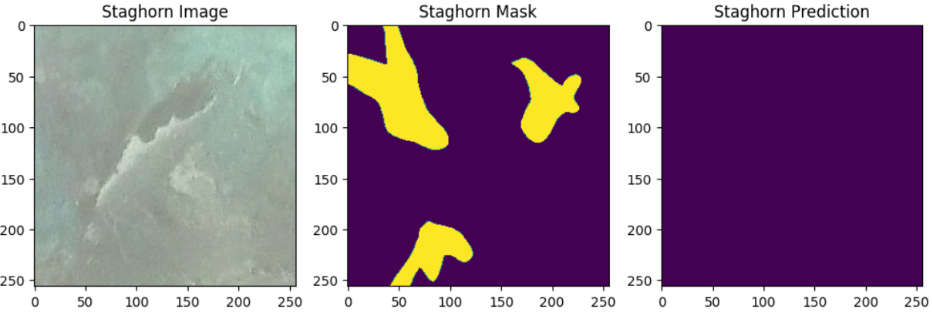
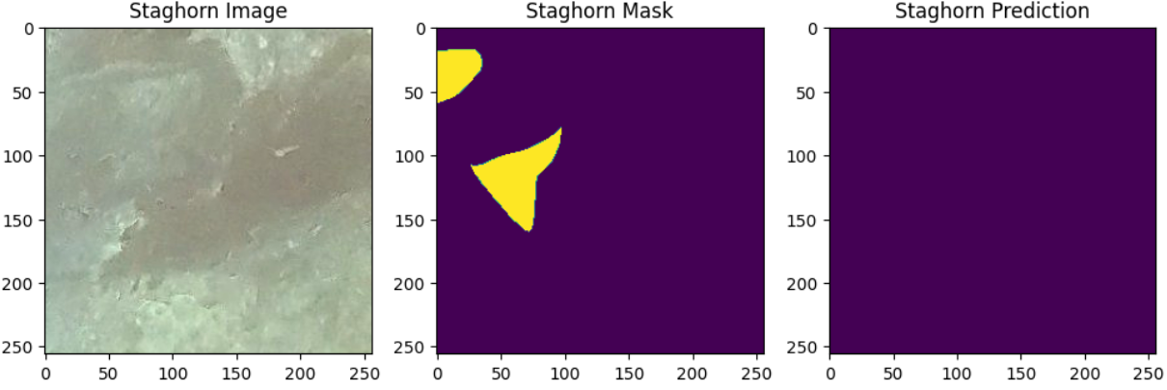
U-Net for Classification
Staghorn images proved to be much more difficult to read than Elkhorn Images
With “no coral” predictions
90.12% classification accuracy
Without “no coral” predictions
99.70% classification accuracy

Slide 15

U-Net for Semantic Segmentation
GOAL: IOU ≥ 0.5
With “no coral” predictions
Mean IoU = 0.73
Background IoU = 0.88
Staghorn IoU = 0.53
Elkhorn IoU = 0.77
Without “no coral” predictions
Mean IoU = 0.77
Background IoU = 0.91
Staghorn IoU = 0.62
Elkhorn IoU = 0.77

Slide 16
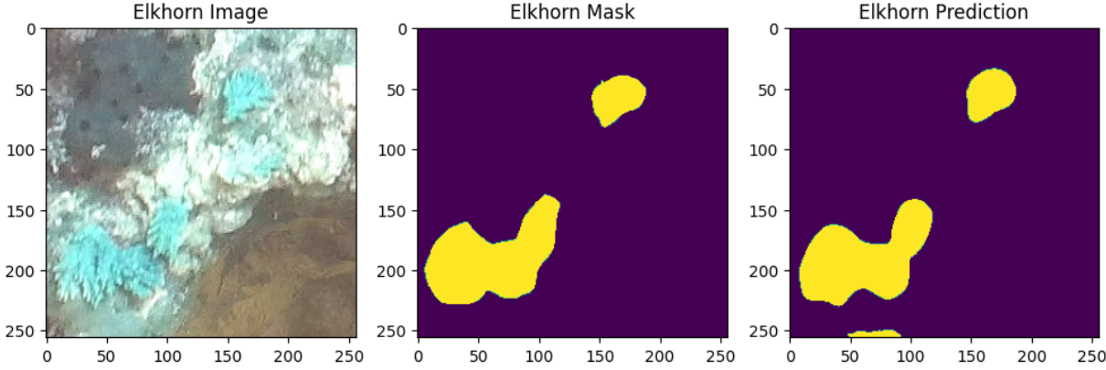
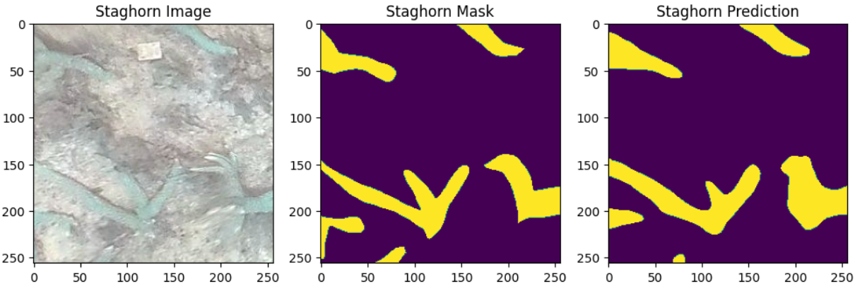
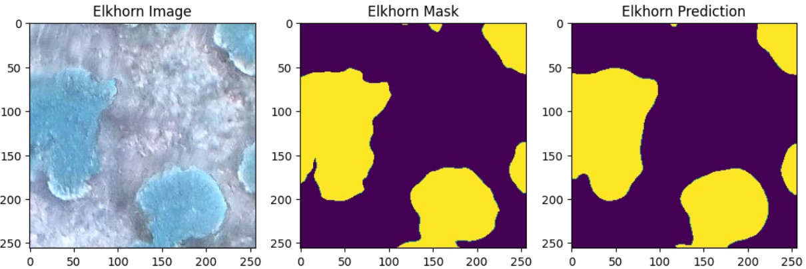
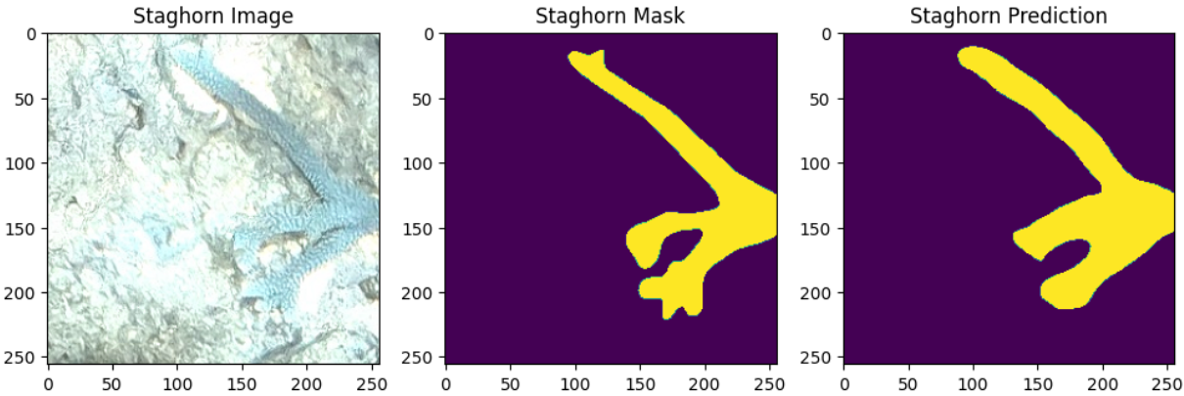
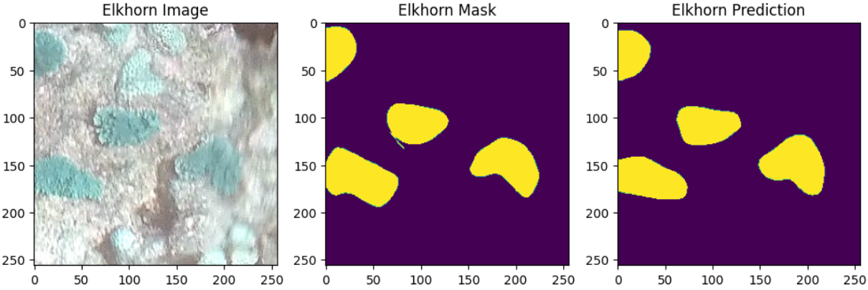
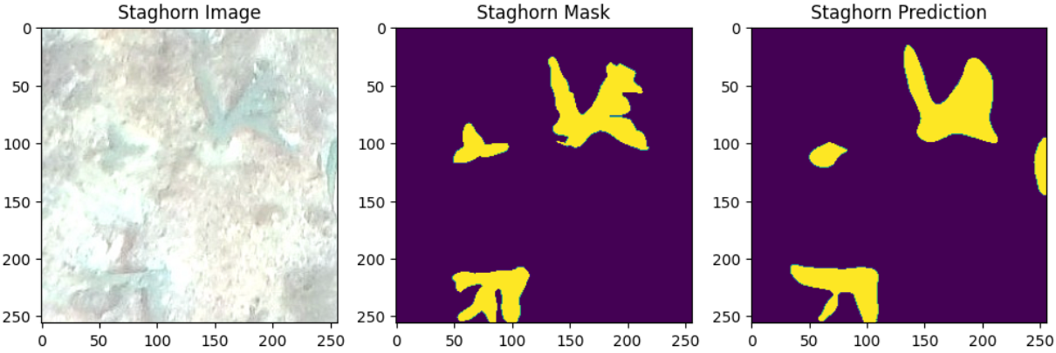

Slide 17
Auto-Generated Mask Mosaics
14 mosaics
Training
Results
U-Net Model
Mean IoU = 0.66
Background IoU = 0.92
Staghorn IoU = 0.59
Elkhorn IoU = 0.47
Testing
2 mosaics

Slide 18
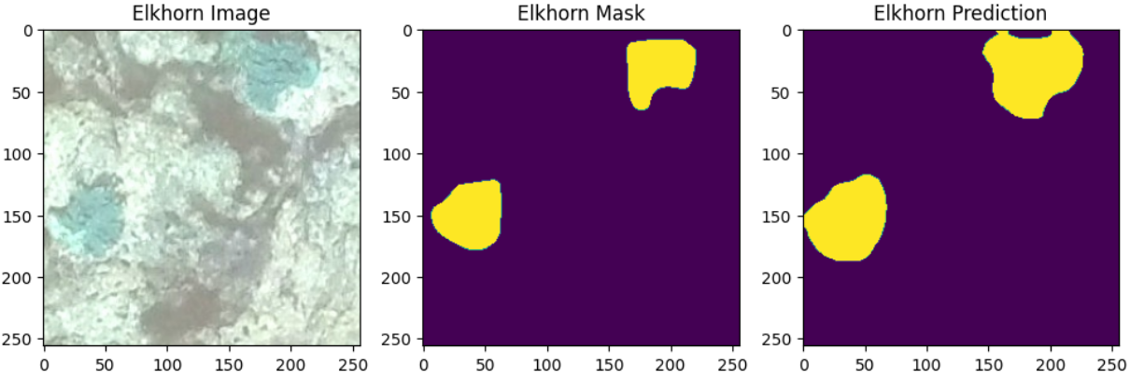
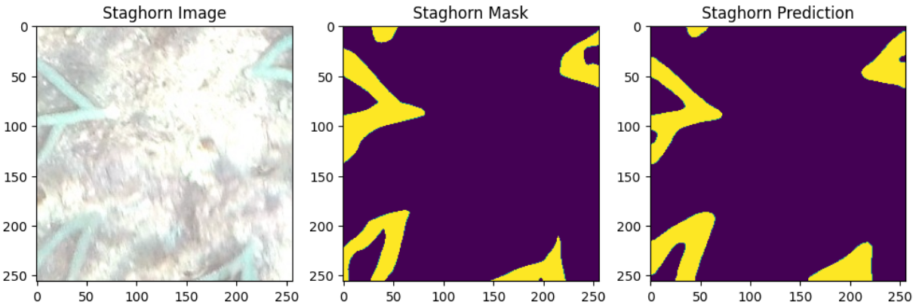
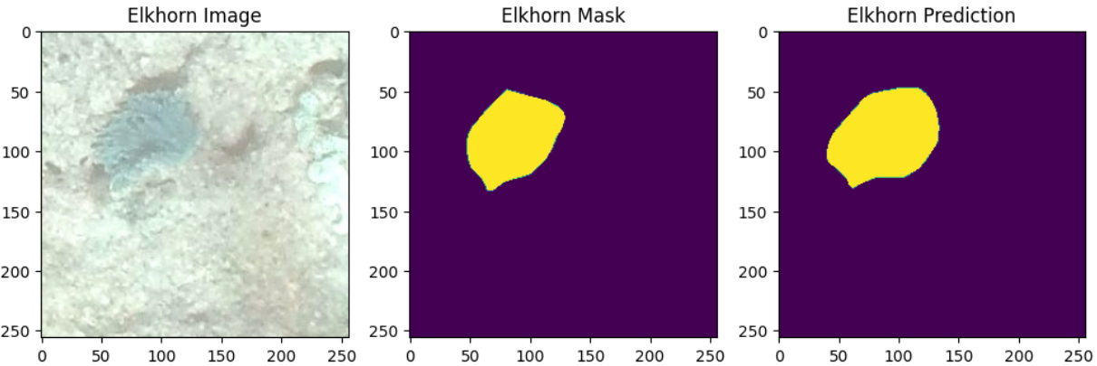
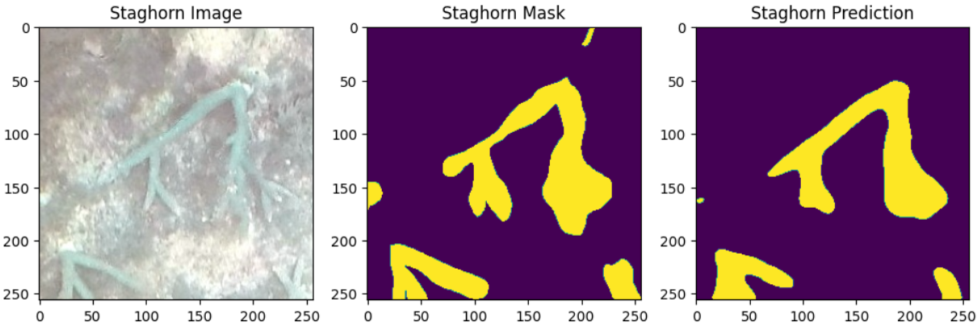
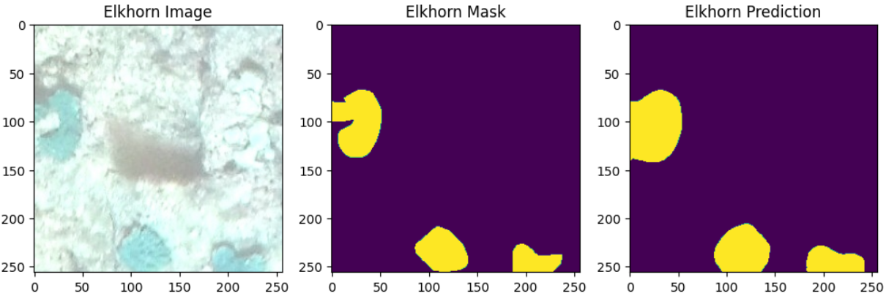
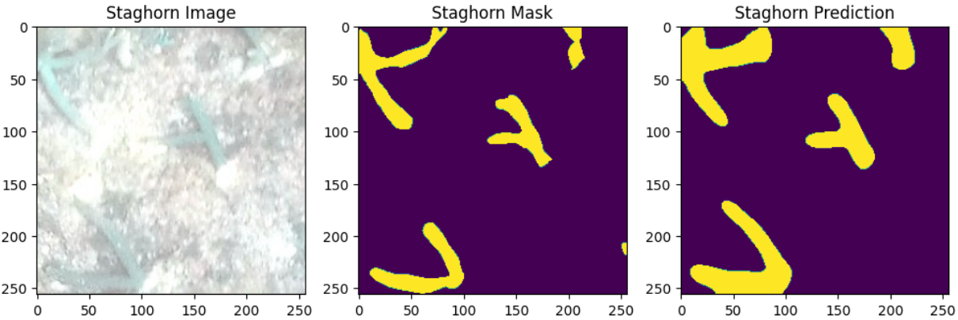

Slide 19
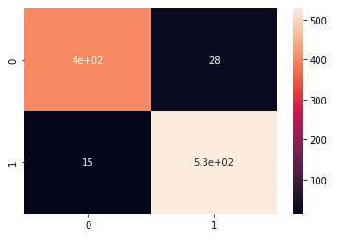
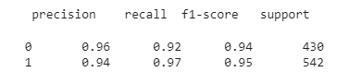
Image Classification Using Vit
Accuracy: 94.86% Confusion Matrix
Elkhorn Accuracy: 93%
Staghorn Accuracy: 96%

Slide 20
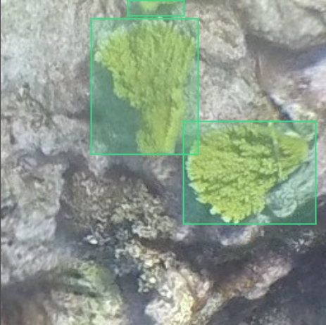
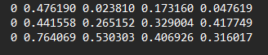
Yolo Dataset
Labelling Data Set for images in train & validate
North 2019 Elkhorn Mosaic patch 2281

Slide 21
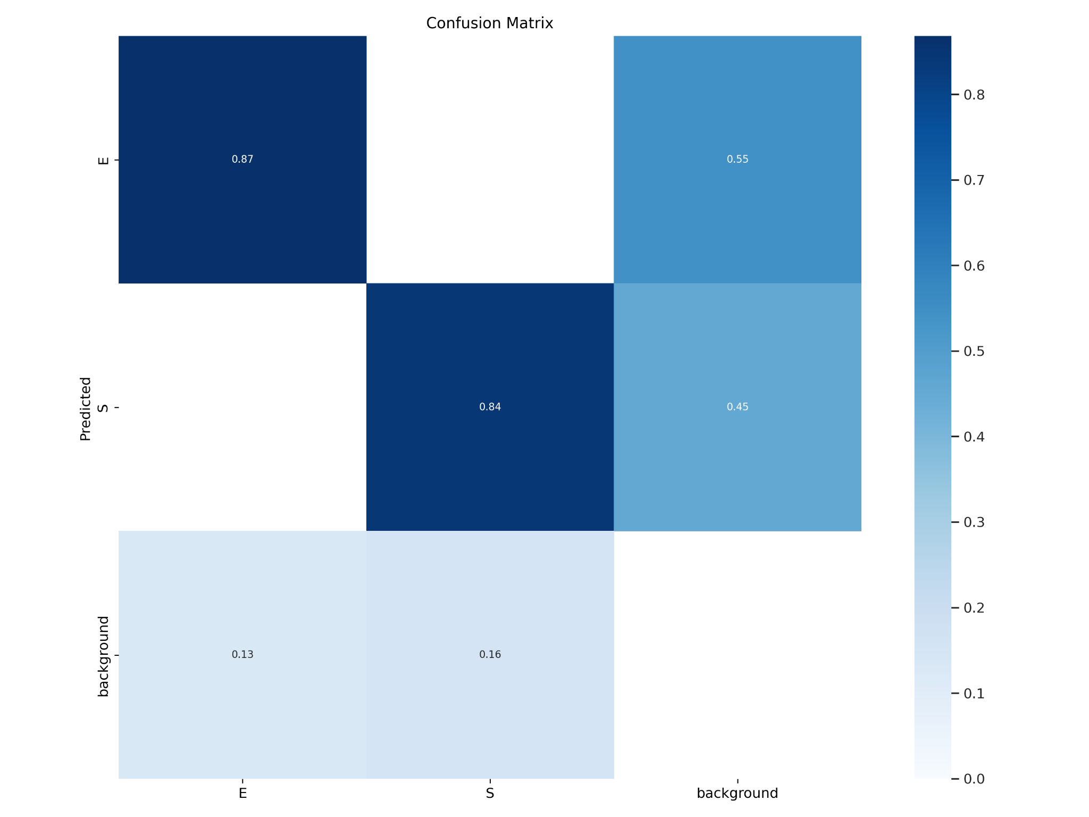
Object detection using Yolo
Metrics for Training
Confusion Matrix
Precision | Recall | mAP
0.78 | 0.81 | 0.815

Slide 22
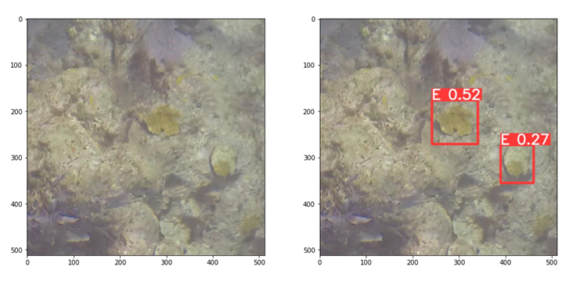
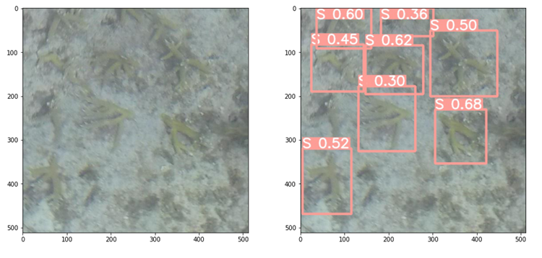
Object detection using Yolo
Elkhorn Sample
Staghorn Sample

Slide 23
Count using Watershed Algorithm
Attempt to count corals using the Watershed algorithm .
input of grayscale images where the high intensity denotes peaks and the low intensities denote valleys.
Each image in the dataset, sharpening->Laplacian filter.
As a binary image, apply distance transform on the image using L2 norm and normalize them.
Extract peaks using a dilation operation and draw contours on the image.
This operation is performed on all the patched images.
And obtained results are as follows
Count of Elkhorn: 915
Count of Staghorn: 1657

Slide 24
Thank You!
Do you have any questions?

